Slide 1
Abhishek Puppala Group 09
Kushal Krishna Vankalapati Group 09
Manisha Lokasani Group 09
Jaswanth Kalyan Polavarapu Group 09
INFO 5082 – Seminar in Research and Methodology

Slide 2
Umpire Gesture Image Recognition
Now a days, sports has become a most famous and being watched world wide. In precise certain, cricket game is most loved by every one. In this game, it is very essential to decide the outcome of each action performed by players in accurate way. As the decision of certain events of such factors effects the entire game, which reflects the outcome of the match summary. In this game, for each action, it has some of signs being displayed by umpires, they are called umpire gestures, they are total of 9 classes six, wide, four, no ball, not out, byes, leg byes, no action, out. Based on image of umpire gesture, we need to predict the class for certain action.

Slide 3
Agenda
Title
Motivation
Background
Abstract(Problem statement)
Literature Survey
Objectives of the Study
Data Set and Data Processing
Research Design(Blueprint/Workflow)
Data Analysis and Model Description
Data Visualization and Results
Conclusion
References

Slide 4
Motivation
I am mostly interested towards cricket sport and image recognition concepts. As going through learning one of the research papers on cricket related projects, I encountered interesting topic over the cricket sport, that is predicting over umpire gestures in cricket game. As per the research papers, most of research papers, where all of them were tried to predict the class labels of 6 gestures such as six, four, wide, no ball, no action, out. I got the idea of working on predicting the other 3 more class labels such as not out, byes, leg byes. By performing the model comparison between the CNN and Classification models.

Slide 5
Background
By comparing previous papers we have got to known that most of the researchers has not made the comparison between classification techniques and neural networks
Moreover no one has the has consider the 9 signals in previous papers they have used only 6 signals.

Slide 6
Abstract
The aim of the research is determine the automated commentary for the cricket using eight various signals like six, four , out , not out , byes , leg byes ,wide, no ball and no action. To achieve this we have used Convolutional neural networks (CNNs) and compared the results with several other classification models like KNN , random forest. We have collected the data manually by watching several videos and collected 2000 images and by using Gans we have generated another 1700 images and total we have 3700 images. Convolutional neural networks (CNNs) is more capable of identifying automated umpire gestures and comparing the outcomes with other classification models . Our research trains our model using a dataset of 3700 photos in an attempt to surpass the accuracy observed in previous studies.

Slide 7
Literature Survey
This study mainly focus on the predicting the automated commentary by using several Markov model, Kmeans clustering, Random Forest, and KNN . And it is also covers the methods which used to calculate the distance methods like Manhattan, Euclidean, and Minkowski distances. (Medha Wyawahare et al., 2023)
The researches also developed an automated labelling apporaches for sports for umpire guesture recognization , by using the hidden hierarchical makrov model , but they have faced the several challenges in achieving the satisfactiory model ratio .( Suvarna Nandyal et al ,2021)
This research work presents a real-time 3D gesture identification system that combines neural network and Naive Bayes classifiers with depth image processing.( Suvarna Nandyal et al ,2021)
They classified motions using logistic regression based on pixel intensity levels and used the Haar cascade Algorithm to recognize human wrists from video streams.( Vaishnavi K.Nair et.al ,2020)

Slide 8
Objectives of study
In this research, we determine the automated commentary by predicting the gestures in game of cricket.
Here, we are predicting over total of 9 labels for our cricket . They are six, wide, four, no ball, not out, no action, byes, leg byes, out.
To achieve this, we try to deploy the models comparison between the CNN (deep learning) and Classification models.

Slide 9
Dataset
As per our problem statement, the data we have selected is image data to process and predict the class labels.
Here, for our model, we need a large group of images with the 9 class labels. We have took the images from online sources such as Kaggle, github and many of other images were extracted using the google images by downloading them manually.
Then, some more images were generated from parsing the previous match videos and taking the screen shots manually.
Also we have taken help of some online platforms, which use GAN algorithms, to generate the images such as runway.ml and top-ai gan image generators.

Slide 10
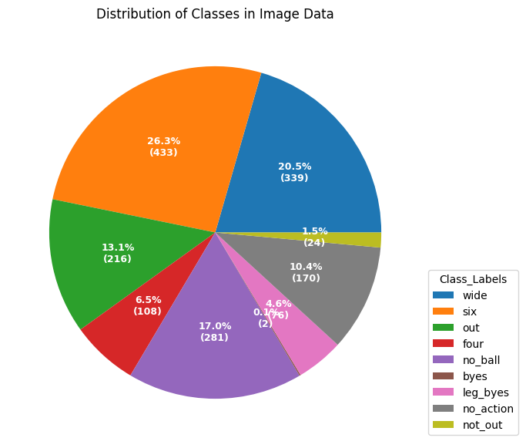
Dataset

Slide 11
Research Design
Here, we are using a dataset of size 2000 images to train our models, that we generated.
Then we classified into comparison of 2 different models:
Deep Learning
AlexNet
ResNet
Classification models
Random Forest
KNN

Slide 12
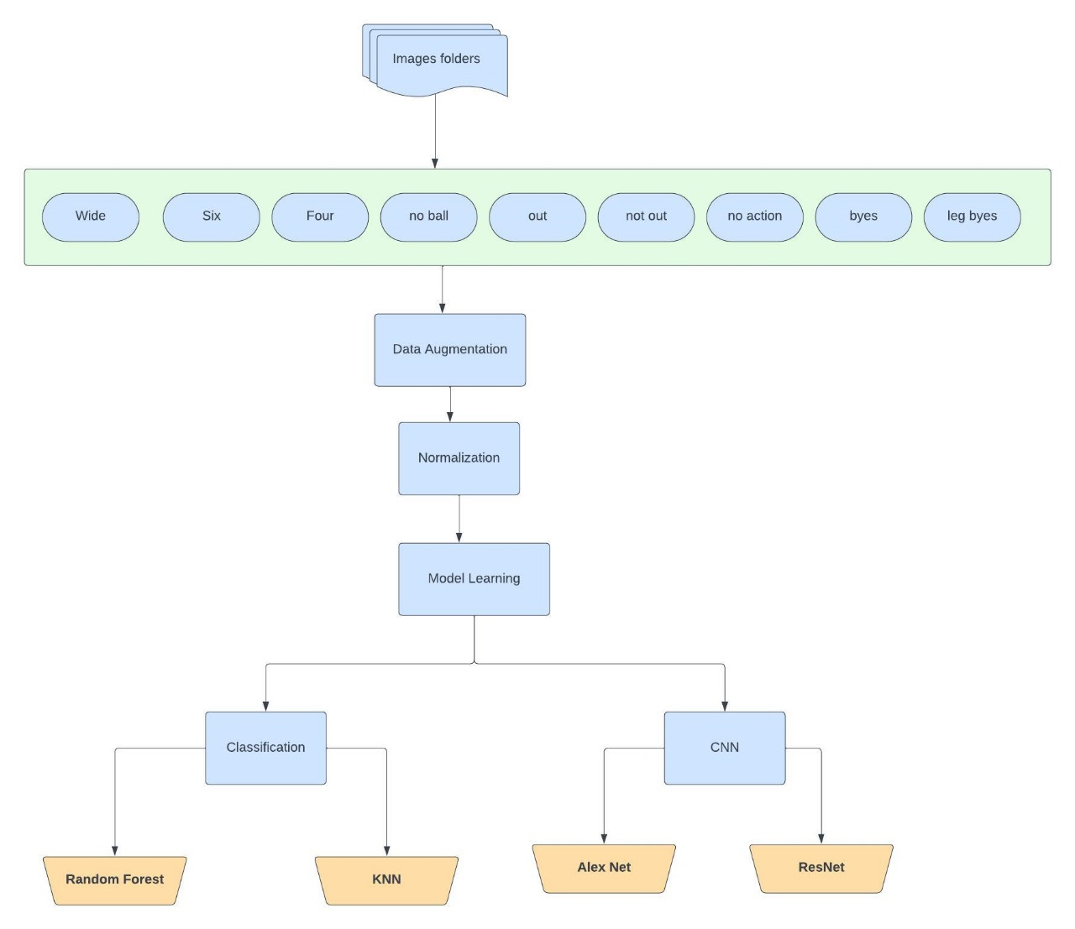
Architecture

Slide 13
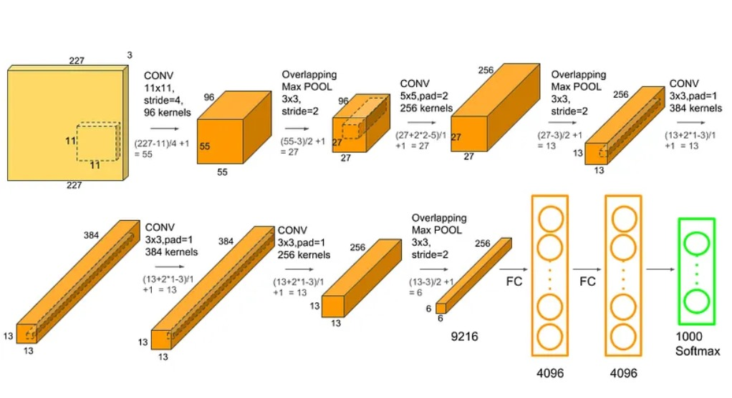
Model Description
Alex Net

Slide 14
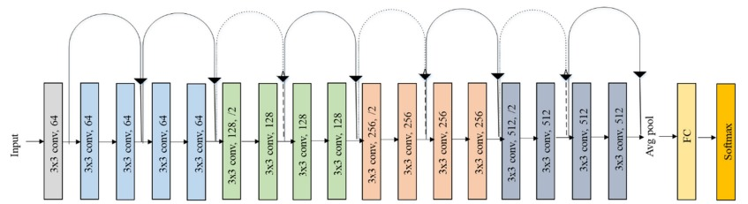
Model Description
Res Net

Slide 15
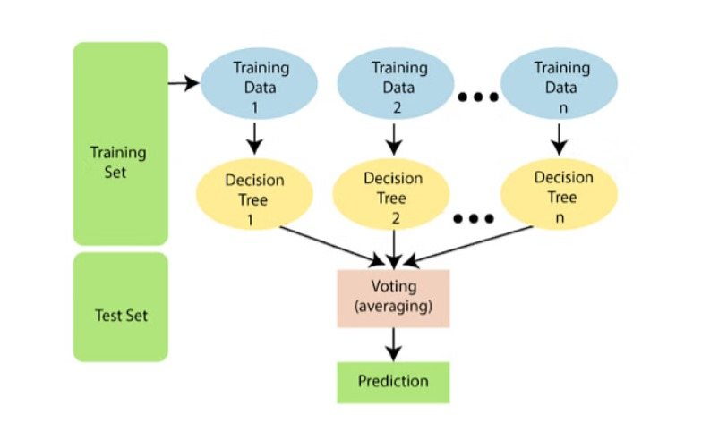
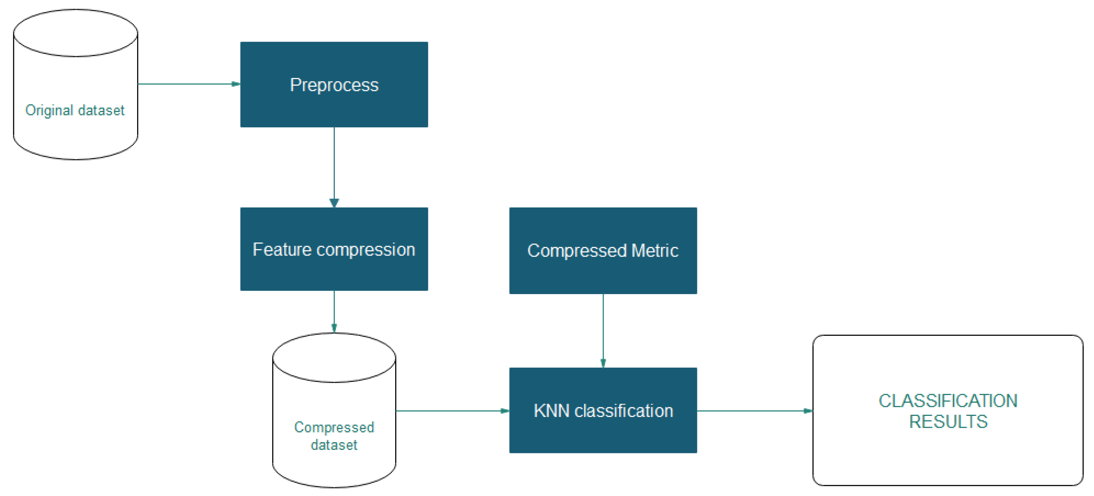
Model Description
Classification models
KNN
Random Forest

Slide 16
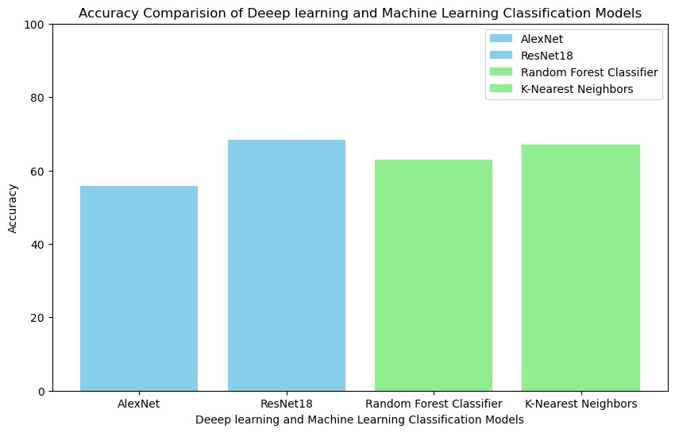
Results

Slide 17
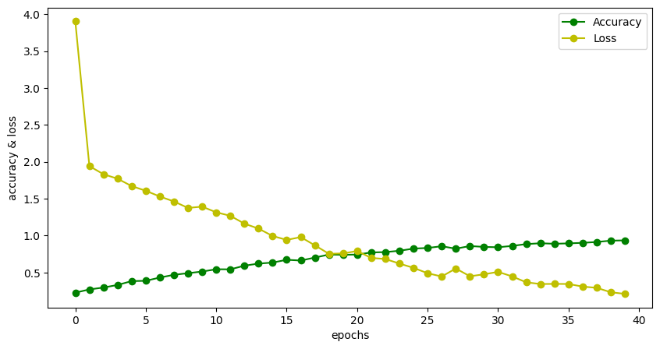
Results
AlexNet
The updated training graph shows an unusual trend, with the accuracy metric starting well above the normal range before sharply declining and then normalizing to expected levels below 1.0 as the epochs progress. The loss also starts at an atypically high level but rapidly decreases, indicating that the model is learning and improving its performance over time. Nonetheless, neither the accuracy nor the loss has stabilized by the 40th epoch, hinting that the model has not yet reached its full learning potential. This peculiar behavior in the early epochs suggests a possible need to investigate the accuracy calculation, data preprocessing, and potentially extending the number of epochs to achieve model convergence, while also ensuring that model validation is conducted to prevent overfitting.

Slide 18
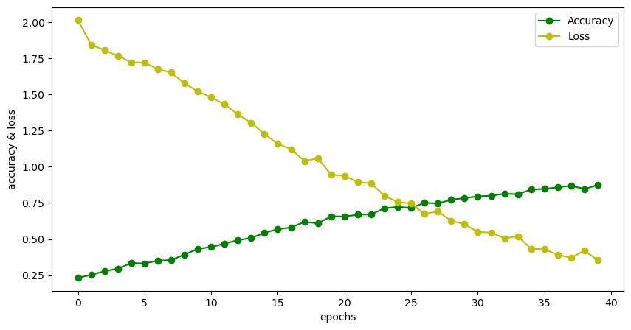
Results
ResNet
The training progress graph indicates that as the number of epochs increases, the model's accuracy initially decreases below the usual starting point of 1, an unexpected behavior, before it begins to ascend, suggesting an improvement in predictive performance. Concurrently, the loss diminishes markedly from a high starting point, aligning with typical expectations of model training dynamics. However, both the accuracy and loss trends have not plateaued by the 40th epoch, implying that the model may not have fully converged and could potentially benefit from additional training. It is critical to validate the accuracy metric calculation, ensure proper data preprocessing, and possibly extend training while incorporating validation to guard against overfitting, thus refining the neural network's efficacy in detecting umpire signals.

Slide 19
Conclusion
Our research talks mainly about the extensive use of convolutional neural networks(CNN) for better use of umpire gesture detection to reduce manual work, with models like ResNet and AlexNet models to show better results compared to general classification models. The CNN models performed better than classification models at processing complicated visual data, responding to differences in gesture expression and multiple variables as accuracy scores of CNN models are better compared to that of classification models. This ability provides better scope This difference underscores the ability of deep learning approaches to transform analyzing sports parameters in real-time contexts where fast and accurate decision-making is critical.
Limitations
By using different models we can have extensive scope of better accuracy while we are limited to only few models like RNN, decision Tree and naive bayes can’t be used

Slide 20
Future Work
We can extend the scope of study by adding the more signals such as timeout, 3rd umpire and impact player.
We can also convert this model to live action by processing the live video and converting the videos into frames and predicting the image class labels.
Also we can convert our output class labels into commentary using the python text to speech engine.

Slide 21
References
Dhanusha T John, Kavya S Kumar, Vaishak T Nair, P Visakh, and BR Poorna. Cricket scoreboard automation using umpire gestures. Inter national Journal of Research in Engineering, Science and Management, 2(7), 2019.
Vaishnavi K Nair, Raakhi Rachel Jose, Parvathy B Anil, Minnu Tom, and Lekshmy PL. Automation of cricket scoreboard by recognizing umpire gestures. International Journal of Innovative Science and Modern Engineering, 6:1–7, 2020.
Suvarna Nandyal and Suvarna Laxmikant Kattimani. Umpire gesture detection and recognition using hog and non-linear support vector machine (nl-svm) classification of deep features in cricket videos. In Journal of Physics: Conference Series, volume 2070, page 012148. IOP Publishing, 2021.
Medha Wyawahare, Amol Dhanawade, Shreyas Dharyekar, Asavari Dhole, and Mugdha Dhopade. Automating scorecard and commentary based on umpire gesture recognition. In International Conference on Advancements in Smart Computing and Information Security, pages 158– 168. Springer, 2022

Slide 22
Thank You

